Slide 1
Checkpoint INTRO TO Data base
Saif dhriwa

Slide 2
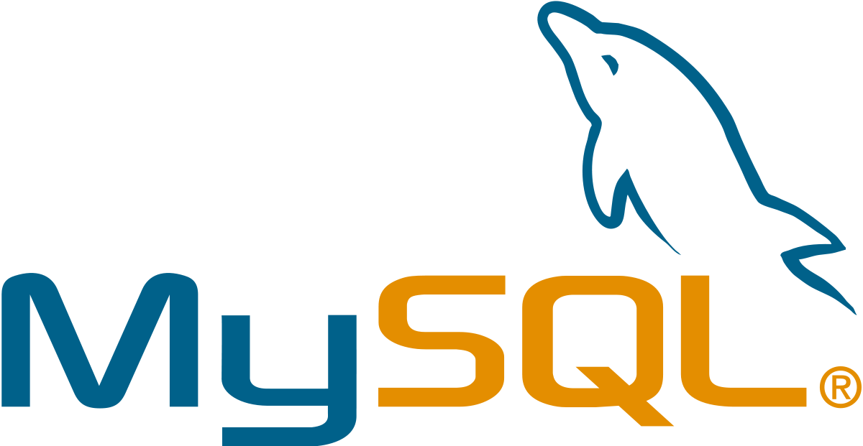

What is MySQL ? :
MySQL is a widely used relational database management system (RDBMS).
MySQL is free and open-source.
MySQL is ideal for both small and large applications.
Features Of MySQL :
MYSQL is Security
Embedded SQL
Transaction Control Language
What is PostgreSQL ? :
PostgreSQL is a free and open-source relational database management system (RDBMS) emphasizing extensibility and SQL compliance.

Slide 3
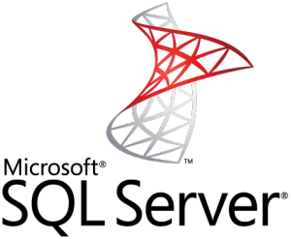
Features Of PostgreSQL :
Asynchronous replication
Freely available under an open source license
Table inheritance
What is SQL Server ? :
Microsoft SQL Server is a relational database management system developed by Microsoft. As a database server, it is a software product with the primary function of storing and retrieving data as requested by other software applications—which may run either on the same computer or on another computer across a network (including the Internet)
Features Of SQL Server :
Support for geographic data
High availability management
Programmability

Slide 4
MySQL VS PostgreSQL VS SQL Server
MySQL offers a scalable buffer pool – developers can set up the size of the cache according to the workload. If the goal is to save CPU and storage space, developers can put strict benchmarks on their buffer pool. Moreover, MySQL allows dividing cache by segments to store different data types and maximize isolation.
PostgreSQL isolates processes even further than MySQL by treating them as a separate OS process. Each database has a separate memory and runs its own process. On the one hand, management and monitoring become a lot easier, but on the other, scaling multiple databases takes a lot of time and computing resources.
SQL Server also uses a buffer pool, and just like in MySQL, it can be limited or increased according to processing needs. All the work is done in a single pool, with no multiple pages, like in PostgreSQL.

